Slide 1
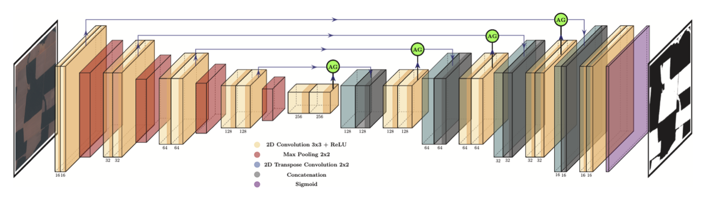
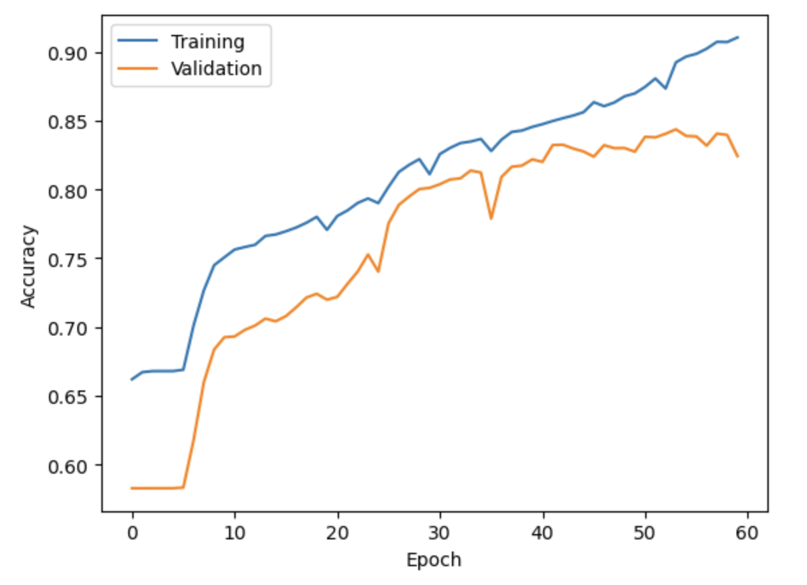
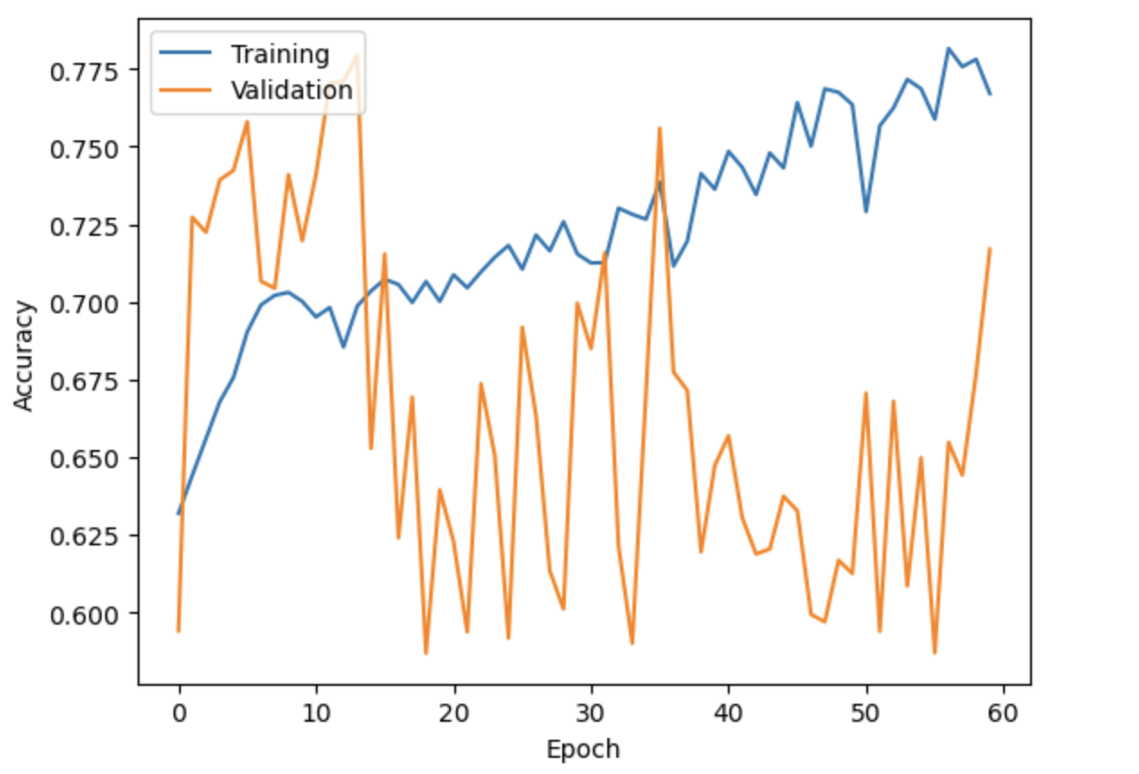
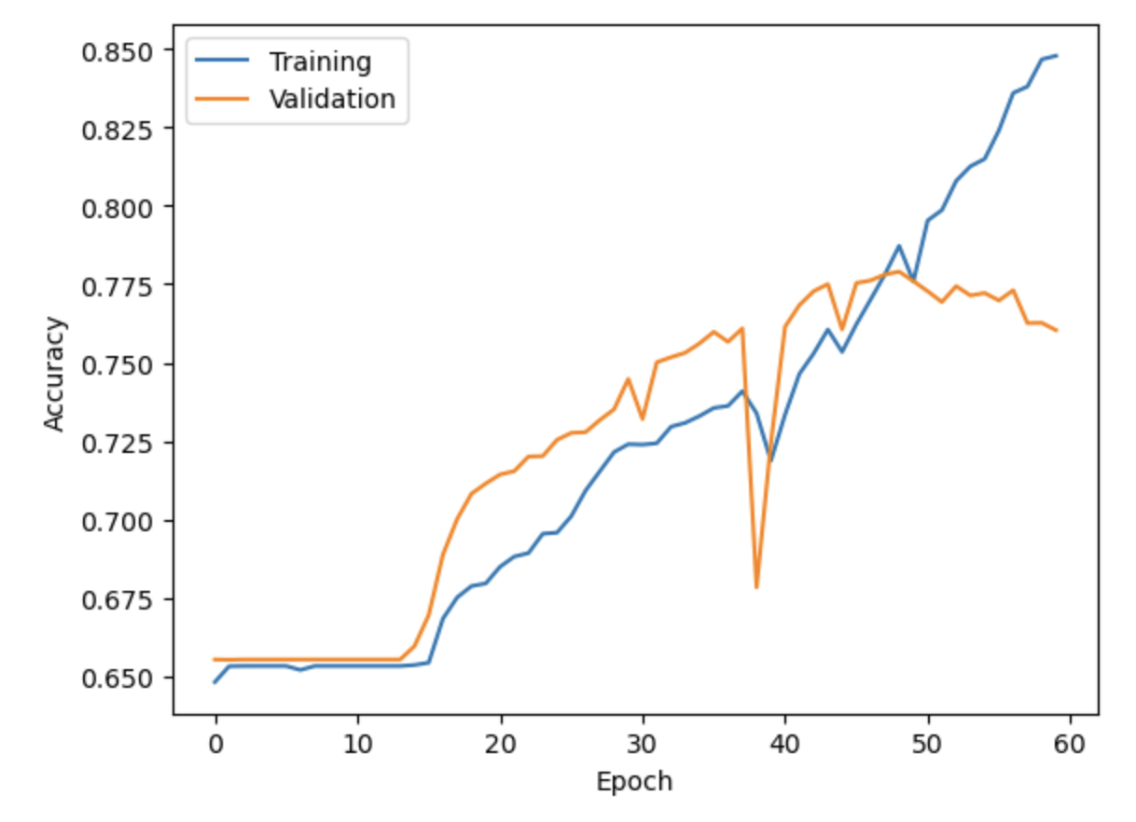
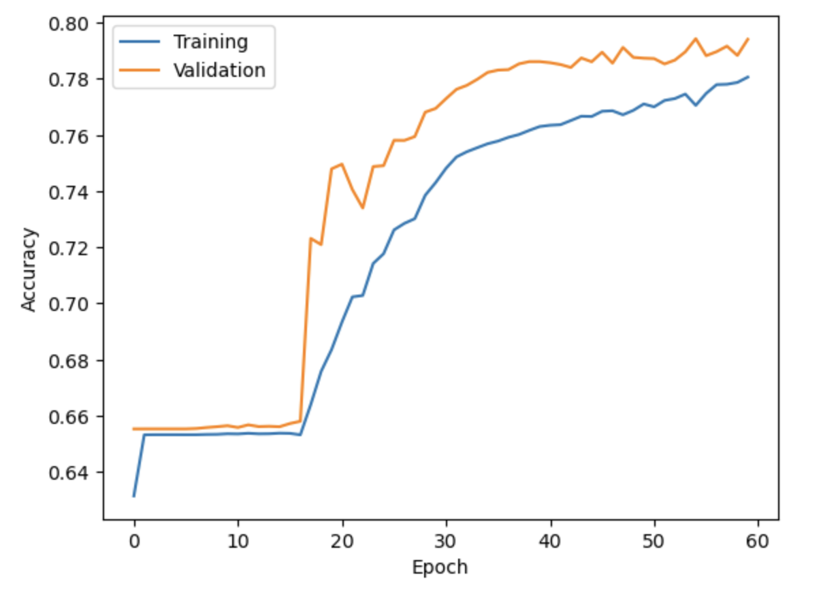
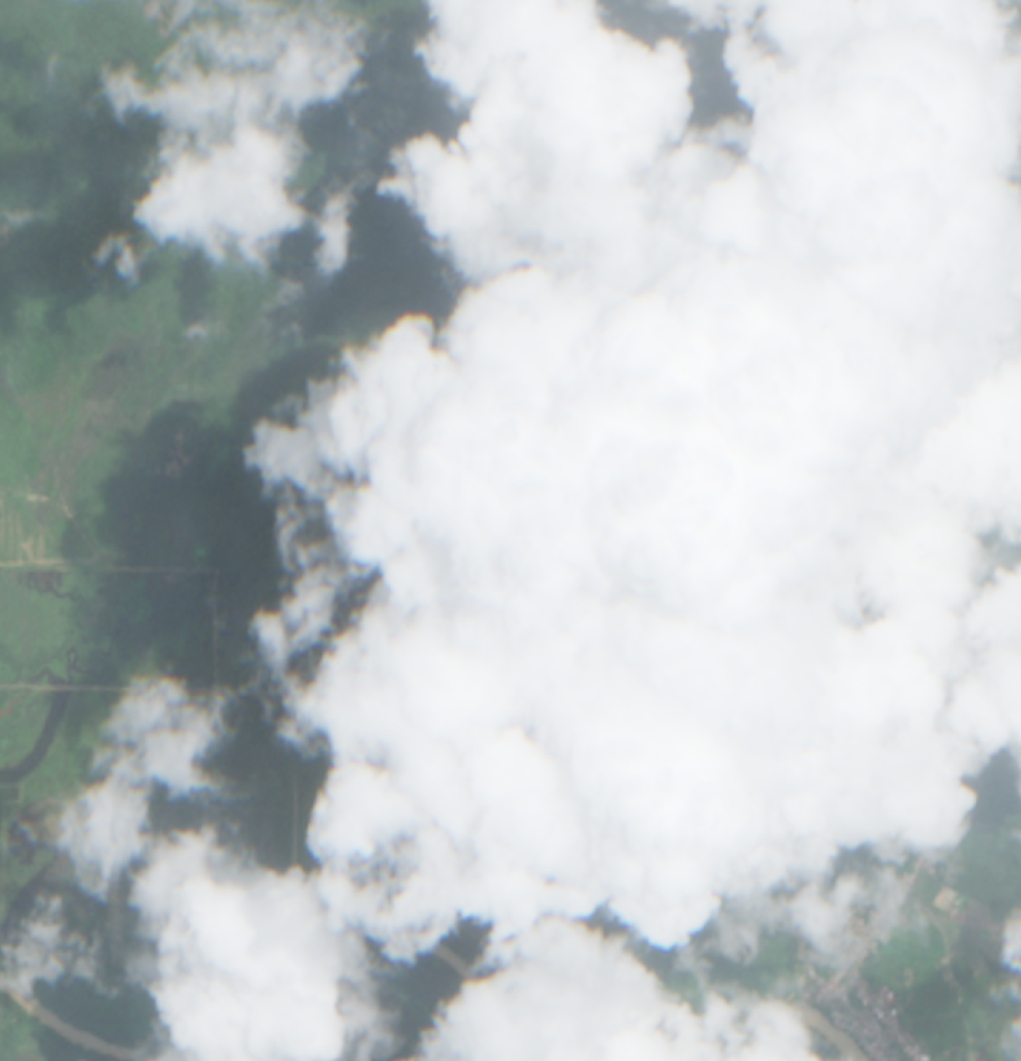
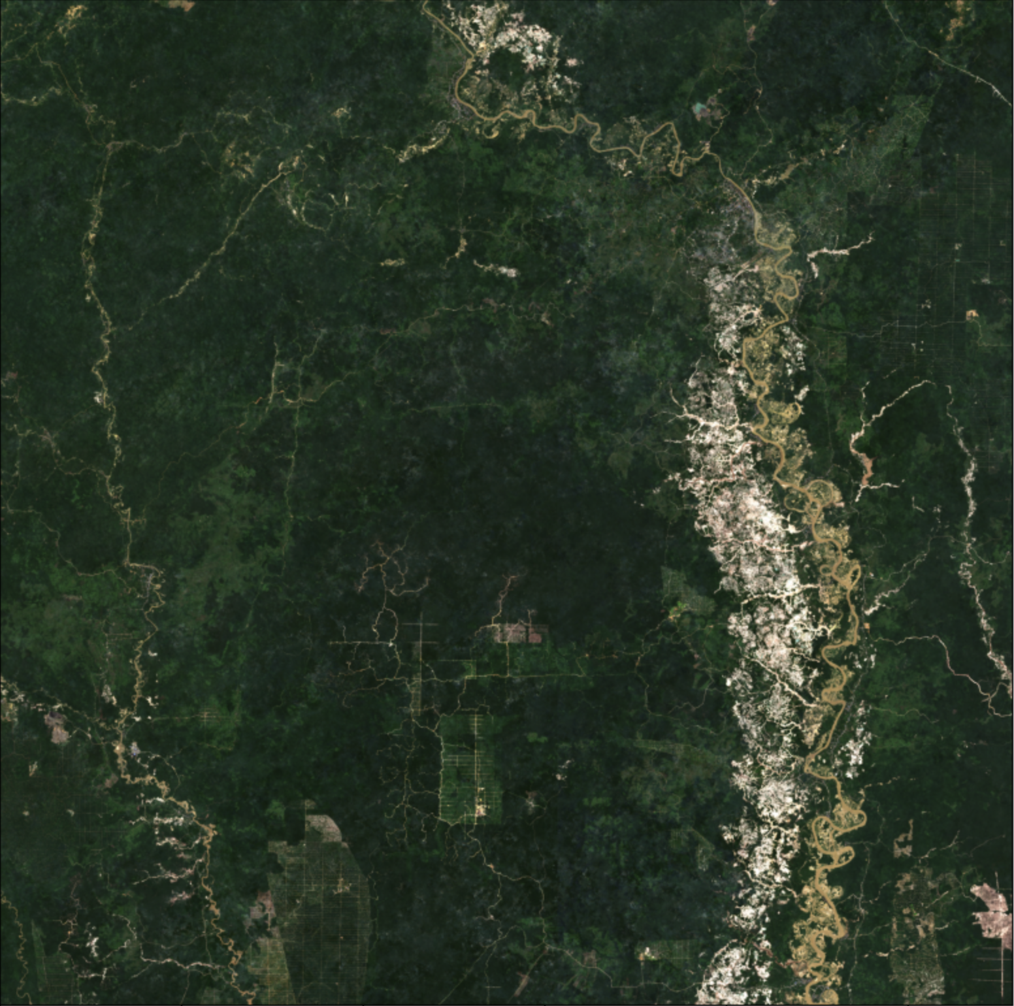
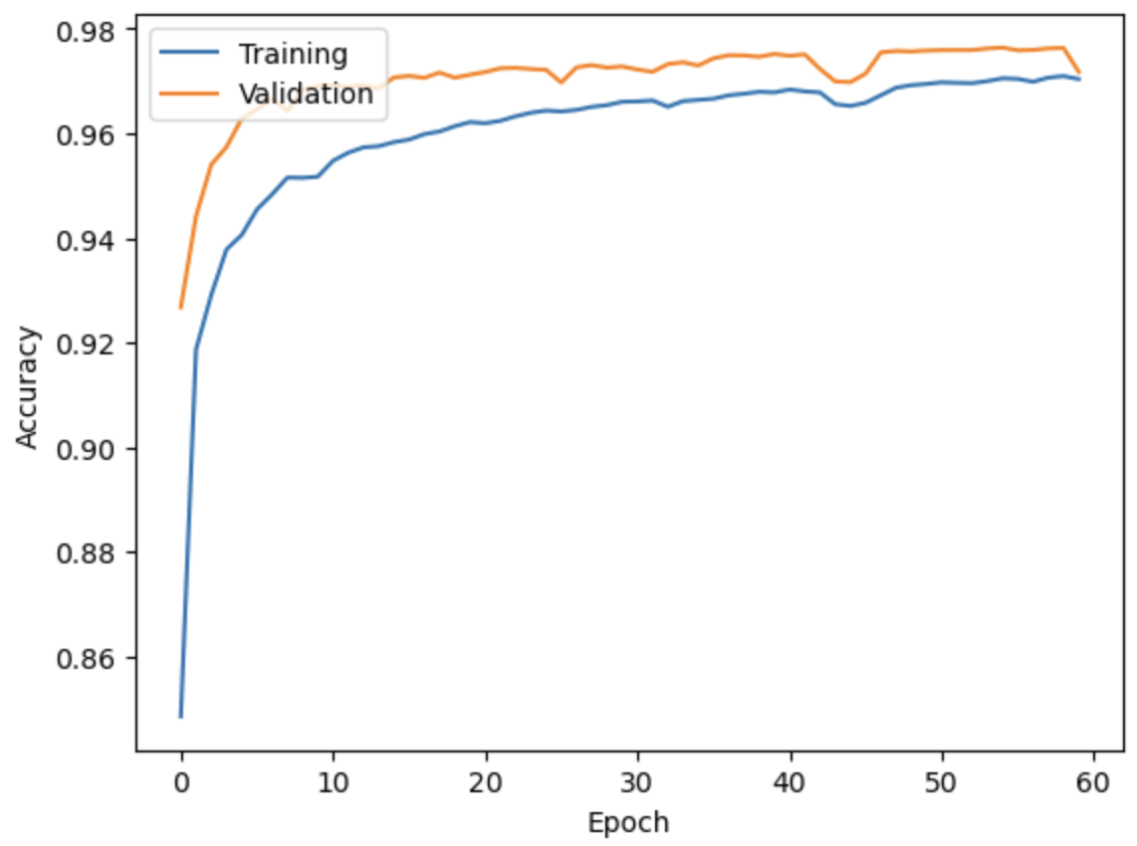
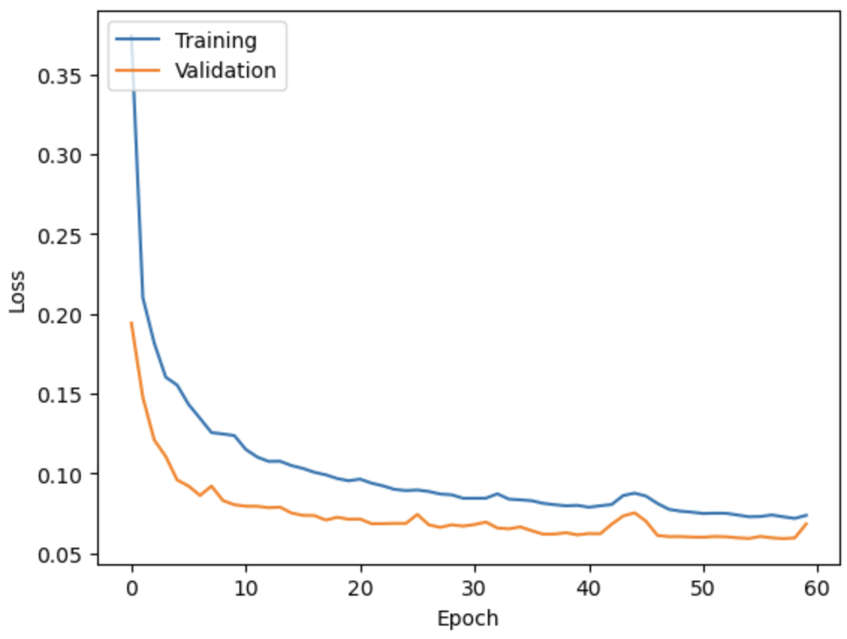
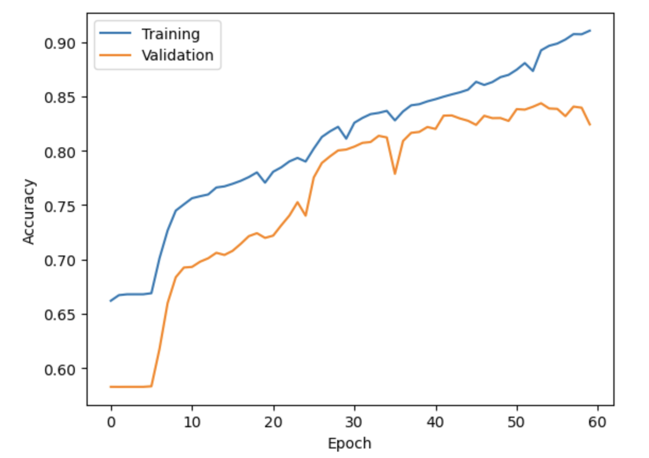
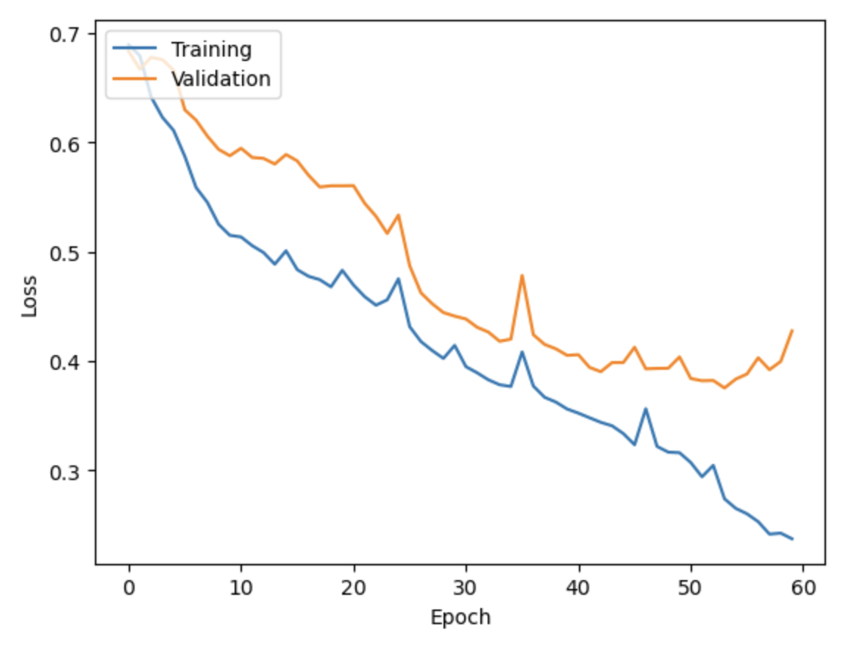
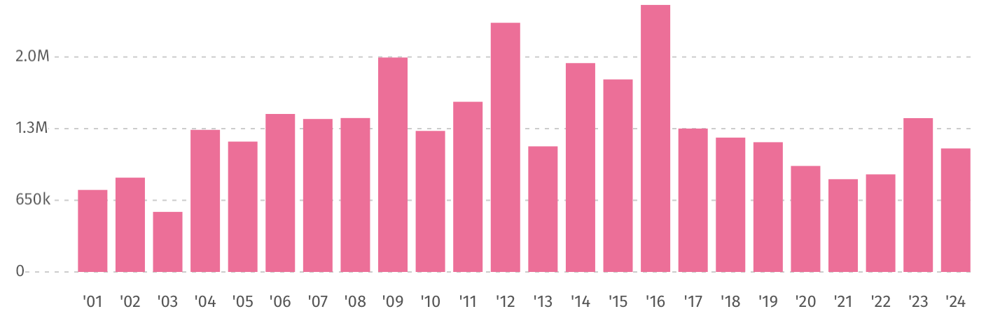
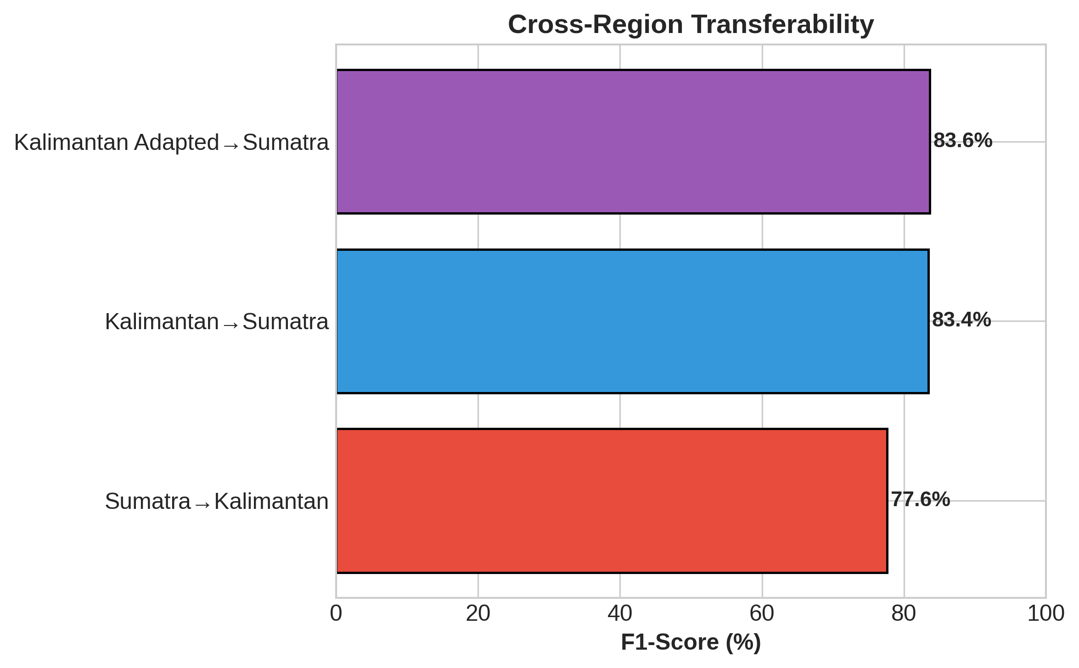
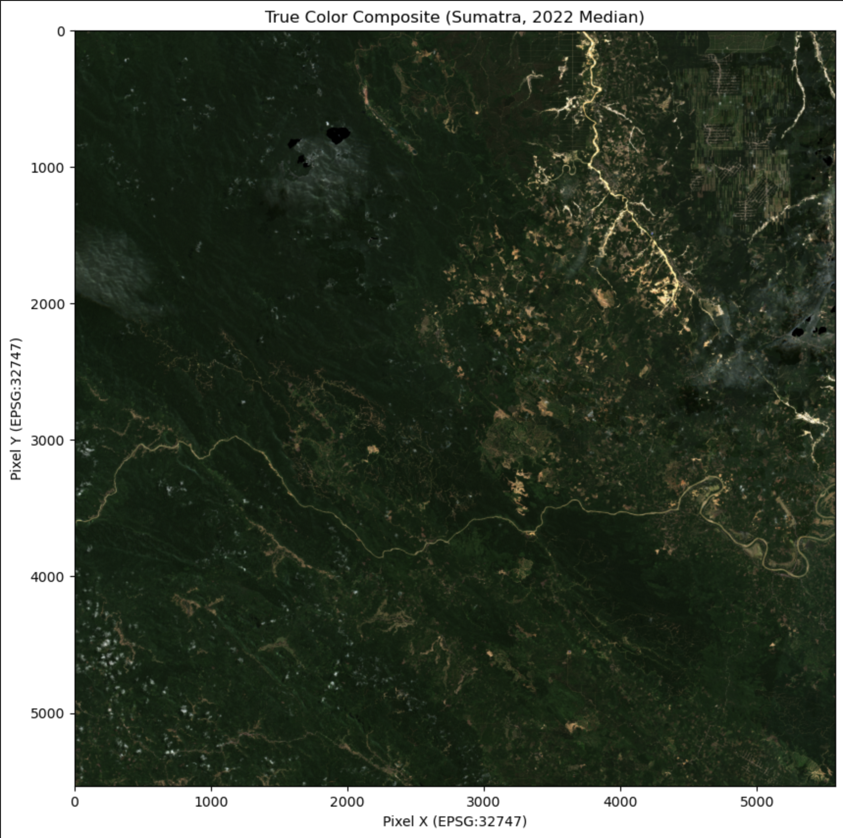

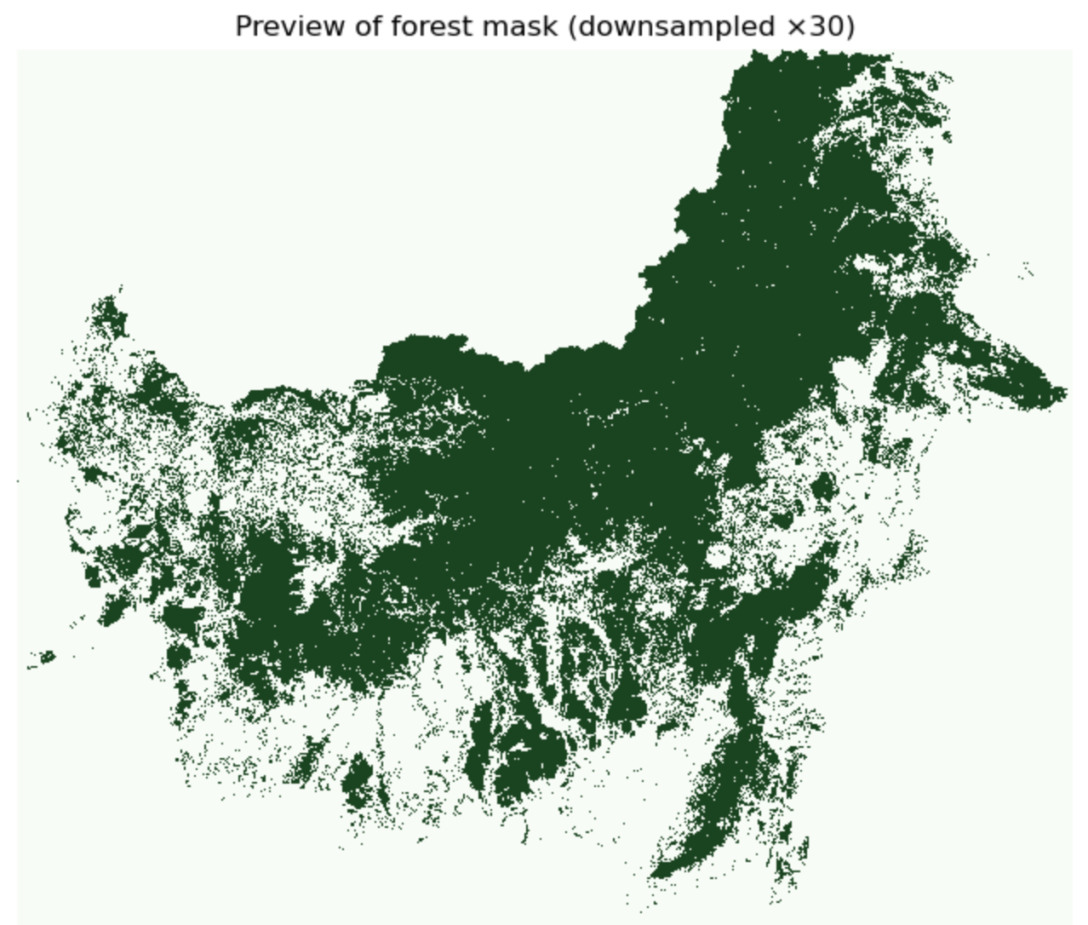
Attention U-Net for Deforestation Detection in Indonesia
Shady Abushady
24206690
Original Paper:
Adaptation of the Model Architecture
Model Performance
Attention-based U-Net for detecting deforestation with satellite imagery
Data Pipeline:
Sumatra AM
Sumatra AM Adapted
Kalimantan AM
Kalimantan AM
Adapted
A difficulty with the Context is that Indonesia’s Climate is tropical and therefore cloudy which obstructs the view from space. For 2022 there were locations which didn’t have images of total cloud cover below 30%. I therefore performed cloud masking by filtering for cloud free pixels of images throughout the year and assembling “Frankenstein” images which end up being cloud free.
To reproduce the model, clone this github repository. Run the notebook titled “Original Paper”. This will download, prepare and ingest the data, train the model and provide some evaluation data.
Model | Test Set | Accuracy | Precision | Recall | F1-Score | Notes
Sumatra AM | Sumatra | 85.1% | 88.3% | 85.1% | 86.7% | Best Performer
Sumatra AM Adapted | Sumatra | 77.9%* | 89.6% | 77.9% | 83.4% | Unstable Training
Kalimantan AM | Kalimantan | 78.1% | 80.7% | 78.1% | 79.4% | Baseline
Kalimantan AM Adapted | Kalimantan | 79.3% | 83.2% | 79.3% | 81.2% | Slight improvement
Original Paper |  |  |  |  | ~96% | Reference baseline
Results: The model reproduced well. The graphs to the right show the accuracy and the loss of the model during training. It achieved similar results to the original (within 5%) with an F1 score of ~96%
I split larger images into smaller patches and split the masks to match them, to be similar in size to the paper. I ended up with 2 datasets, one for the island of Sumatra and one for Kalimantan with in total 1025 train, 218 validation, 225 test samples (~50% class balance).
New Context: Deforestation in Indonesia (home to the 3rd largest forest)
Original Model:
Evaluation of the Performance
79%
of deforestation in Indonesia is caused by agriculture, a large portion of that being palm oil.
The original model from the paper has decent performance, coming in at just over 90% train accuracy. The issue is the model is overfitting strongly.
The models with the Indonesian data performed about 10% worse than the models with the South American data from the original dataset. This could be due to several factors: cloud cover in Indonesia, the reduced quality in ground truth data in Indonesia (80.7% accuracy vs ~98% in original paper) and the difference in biomes and ease contrast of forest vs non-forest in Brazil.
Through ablation we can determine that dropout was helpful for the Kalimantan dataset (+3%) but caused major instability for the Sumatra dataset.
For the Kalimantan dataset it reduced overfitting
Effectively and aided in generalisation,
this can further be proven by the
cross-region transferability test conducted
where regions were tested on the other
regions predictor. Here the Kalimantan
Adapted Model performed best, showing that
the Sumatra model might have memorised
the data rather than generalised for
unseen data.
Overall the model performed to an acceptable level
considering the publicly available data for Indonesia.
Palm Oil is an extremely productive crop. Producing 4-5 times more tons of oil per hectare than the second most efficient crop, soybeans. The global average of t/ha of palm oil plantations is 3.3 t/ha (soybean being at 0.7 t/ha). In Indonesia it is even more productive with the average being 5.4 t/ha. In a world with limited arable land, it means we can grow more on less land.
Loss of tree coverage in Indonesia per year in ha
Potential ways to address the issue:
Overfitting can be prevented with regularisation. Popular forms of regularisation include L2 regularisation, L1 regularisation and dropout.
I chose to test dropout since it was mentioned as a potential add on in the original paper.
Datasets
Sentinel 2: 4-Band Satellite Imagery (2022)
The above graph shows that Indonesia was making progress on reducing deforestation. Averaging below 1Mha of tree coverage loss from 2019 to 2022 but then trending upwards again in recent years, averaging over 1Mha a year from 2022 and 2024. This shows that current methods are not that effective.
Sentinel 2 is under creative commons license, making it freely available to anyone to use.
It contains 4 Band satellite images (Red, Green, Blue, Near Infra Red) with a zoom of 10m per pixel
It is the same origin of data used in the original paper.
I chose the to collect image from the islands of Sumatra and Kalimantan since they are affected by deforestation the most in Indonesia (and the consequences of it, like floods)
How this affects people, environment and economy
Discussion and Critical Reflections on SDGs
SDG12 - Responsible production:
Deforestation in Indonesia has caused devastating floods, leading to famine, loss of infrastructure and death (836 deaths in the floods of 26/11/2025).
On one hand the increase in agriculture improves the economy as more goods are produced but on the other hand the reduction in forests increases these events frequency and severity.
In terms of the environment, deforestation harms local biodiversity, reduces carbon sinks and increases local pollution in Indonesia.
Monitoring and governance can encourage sustainable agriculture and mining, however it takes responsible government action, supporting vulnerable people rather than punishing them.
SDG 13 - Climate Action:
MapBiomas: Forest Coverage Mask (2022)
The model has the potential to slow deforestation given that action is taken by the government. The model also makes use of already existing data and is rather efficient with 2M parameters. The pros of saving the forest would massively outweigh pollution caused by the model if appropriate action is taken, maintaining carbon sinks and protecting vulnerable communities from extreme weather events.
Current government action, and future recommendations
MapBiomas is under creative commons license, making it freely available to anyone to use.
I chose 2022 since it had the highest accuracy mask of other years.
98.5% of Forest area was correctly marked as Forest.
80.7% of area marked as Forest was actually Forest.
It is at a 30 meter scale.
The Indonesian government is committed to making change: they fined mining and palm oil companies 2.7 billion USD for operating in forest areas (just recently, on December 8th 2025).
This system could help governments support local communities to be more sustainable by identifying smallholders and govern over larger corporations who are deforesting.
SDG 15 - Life on Land:
The model promotes sustainable forest management (Indicator 15.2.1). If deforestation is reduced by the model it will massively benefit biodiversity.
SDG 2 - Zero Hunger:
Increasing the proportion of area under sustainable agriculture
Shady Abushady
Shady.Abushady.25@ucl.ac.uk
https://github.com/Shadyabu/deforestation_indonesia

Slide 2
Notes
79% of deforestation done to make space for agriculture
https://www.globalforestwatch.org/dashboards/country/IDN/?map=eyJjYW5Cb3VuZCI6dHJ1ZX0%3D
3.3 tons per hectare of palm oil vs 0.7 tons per hectare for the second most efficient crop (global average, it is even at 5.4t/ha in Indonesia). Solution is not to punish farmers but to support the most vulnerable in making a livelihood in a sustainable manner (maybe investing in more processing plants in areas with high deforestation risk since 50% of palm oil is exported unprocessed)
https://www.mdpi.com/2073-4395/15/6/1465
https://www.globalforestwatch.org/dashboards/country/IDN/?map=eyJjYW5Cb3VuZCI6dHJ1ZX0%3D
Were on right track: Averageing below 1Mha of tree coverage loss from 2019 to 2022 but then trending upwards again in recent years, averageing over 1Mha a year from 2022 and 2024. Tree coverage loss is not the same as deforestation. Tree coverage and deforestation are measured when an area has a >30% loss of tree canopy coverage, it counts as deforestation if it is within the limits of a forest and tree coverage if not.
Deforestation creating horrible floods, devastating local infrastructure and leading to famine.
https://carbon-pulse.com/464583/
https://www.reuters.com/sustainability/climate-energy/indonesia-promises-action-any-mining-permit-violations-sumatra-floods-toll-about-2025-12-04/
The Indonesian government is committed to making change: they fined mining and palm oil companies 2.7billion USD for operating in forest areas (just recently, on December 8th 2025)
https://www.reuters.com/sustainability/indonesia-fines-dozens-palm-oil-mining-companies-23-billion-operating-forest-2025-12-08/
https://www.reuters.com/sustainability/climate-energy/indonesia-promises-action-any-mining-permit-violations-sumatra-floods-toll-about-2025-12-04/
MapBiomas Indonesia for mapping – it is under creative commons license (https://brasil.mapbiomas.org/en/perguntas-frequentes/) https://mapbiomas.org/analise-de-acuracia
Sentinel-2 4band data for training() 10m pixel https://www.copernicus.eu/en/documentation/information-material/esa-cci-open-data-portal-projectdata-access

